Slide 1

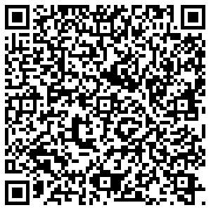



NATIONAL PROSECUTING AUTHORITY
SEXUAL OFFENCES AND COMMUNITY AFFAIRS (SOCA)
Reciprocal Maintenance Orders
Reciprocal Enforcement of Maintenance Orders Act 80 of 1963
Reciprocal Enforcement of Maintenance Orders (Countries in Africa) Act 6 of 1989
Maintenance Act 99/98 as amended
Sexual Offences and
Community Affairs (SOCA) Unit
2023
Date

Slide 2
International Maintenance
Reciprocal Enforcement of Maintenance Orders (REMO)
Two REMO Acts (1) REMO Act 80 of 1963 (2) REMO Africa Act 6 of 1989
List of Reciprocating countries
If country not listed –Look at UN Convention of the rights of the child (article 26 and 27)
The Hague Convention International Recovery of Child Support and Other Forms of Family Maintenance.
Department of Justice Codified Instructions Family Courts on Maintenance 26 of 2015
Deposition Affidavit
Forms (see page 40 ) Annexure V (example on page 119 of DOJ Code 26 of 2015)
Annexure W – Australia (example on page 122 of DOJ Code 26 of 2015)
Annexure X (J281) court order (example on page 123 of DOJ Code 26 of 2015)
Statement of grounds on which application might be opposed (2 sets in case of spousal maintenance) page 46
Recent Photo of respondent (for sheriff in other country)
Certification of documents –page 50

Slide 3
International Maintenance
Reciprocal Enforcement of Maintenance Orders (REMO)
South Africa have an agreement to some proclaimed countries in terms of the REMO Acts
Where a country is not listed in terms of REMO – look at the UN Convention on the Rights of the Child
UN Convention on the Rights of the Child have 196 countries that ratified the UN treaty
UN Convention on the Rights of the Child –articles 26 and 27 deal with child maintenance
The Hague Convention International Recovery of Child Support and Other Forms of Family Maintenance -45 countries but South Africa is not a signatory
All maintenance courts in South Africa can assist with International maintenance FREE OF CHARGE
Maintenance courts use the Department of Justice Codified Instructions Family Courts on Maintenance 26 of 2015
The DOJ Code 26 of 2015 is available at all maintenance court libraries (see from page 40 par 43)
There are two (2) Acts that deal with Reciprocal Enforcement of Maintenance, namely: Act No 6 of 1989 for countries in Africa and Act No 80 of 1963 for the rest of the world. The main distinction between the two (2) Acts are the central authority.
In respect of the countries of Africa, the central authority is the Director-General (DOJ& CD) and in respect of the rest of the world it is the Minister of the Department of Justice and Constitutional Development.
Most important document is your Deposition affidavit

Slide 4
Proclaimed countries in terms of the Act
REMO Act 80 of 1963 | REMO Africa Act 6 of 1989
Australia Capital Territory - New South Wales - Northern Territory - State of Queensland South Australia - Tasmania - State of Victoria - Western Australia | Botswana,
Botswana | Kenya,
Canada Alberta - British Columbia - Province of Manitoba - North West Territories - Province of Ontario | Lesotho,
Cocoa (Keeling) Islands | Malawi,
Cyprus | Namibia,
Fiji | Nigeria,
Germany | Swaziland,
Guernsey (Bailiwick of) | Zambia and
Hong Kong; Swaziland | Zimbabwe
Isle of Jersey; Isle of Man
Kenya; Namibia; New Zealand
Lesotho; Nigeria; Norfolk Island;
Malawi; Sarawak; Singapore; St Helena
United Kingdom England - Northern Ireland - Scotland - Wales

Slide 5
Provisional maintenance orders made in South Africa and transmission thereof (Section 8 of Act 80 of 1963)
The country should be a proclaimed country in terms of the Act
Enquiry to be held in terms of Maintenance Act 1998 (Section 10) in absence of respondent (Section 8(1) of Act 80 of 1963)
Evidence of all witnesses at enquiry to be read over and signed by them (Section 8(1))
Court to make provisional order with a view to the confirmation of the provisional order in a proclaimed country (Section 8(2))
Orders should state separately the amounts of maintenance payable in respect of the wife and each child. It should also state until what age maintenance in respect of each child should be paid (DOJ&CD Codified Instructions)
The order must explicitly state that it is made provisionally and that it has no effect unless and until confirmed by a competent court in the proclaimed country.
In order to facilitate the identification of the defendant and tracing his whereabouts in the proclaimed country, all relevant information in regard to that person must be furnished.
Provisional order to be forwarded – together with relevant documentation – to DOJ&CD Head Office for transmission through diplomatic channels (Section 8(2)). The following documents should be forwarded:
  Four certified copies of the provisional order
  The deposition or evidence of the complainant together with three certified copies of the deposition or evidence
  Birth certificate(s) of the child(ren)
  Marriage certificate (if applicable)
  A statement of the grounds on which the making of the order might have been opposed together with three certified copies of the statement
  A photograph and description of the defendant – in prescribed format
  The original exhibits referred to in the complainant’s evidence (These exhibits must be duly endorsed in prescribed format)

Slide 6
Provisional maintenance orders made in South Africa and transmission thereof (Section 8 of Act 80 of 1963) (2)
In case where a provisional order is made against a respondent in a proclaimed country towards the maintenance of both his wife and children, two separate sets, one applicable to the wife and another to the children, together with the grounds on which the making of the order might have been opposed, should be furnished.
Once confirmed by a court in the proclaimed country, the order needs to be sent via diplomatic channels, back to the court in RSA where provisional order has been made, as a final order.
If the court in a proclaimed country before which a provisional order has come for confirmation, refers the case for further evidence to the court of origin in the Republic, the maintenance court proceeds with the enquiry as if no provisional order has been made (Section 8(3)). The maintenance court may then take into consideration the contents of the depositions of witnesses in the court before which such an order has come for confirmation.
Take note of Section 5 of Act 6 of 1989 which provides for:
    the defendant resident in an African country to consent in writing to the provisional order
    Proof of receipt of sufficient notice by the defendant to attend proceedings at which provisional order has been made to be forwarded with provisional order together with relevant documentation

Slide 7
Registration of maintenance orders made in a proclaimed country (Section 3 of Act 80 of 1963)
When a certified copy of a final maintenance order is forwarded via diplomatic channels to a court in RSA with jurisdiction (district where the defendant resides), the court shall on receipt register such order (Section 3)
The particulars of the order must be entered into a register kept for this purpose (DOJ&CD Codified Instructions) and the entry should include the date, place and proclaimed country in which the order was made
DOJ&CD head office must be notified of the date of registration of the order
Notice must be sent to the defendant via registered mail to his last known address calling upon him to effect payment (DOJ&CD Codified Instructions)
The defendant is only liable for the payment of maintenance under such an order received from abroad as from the date of registration of the order in the Republic (DOJ&CD Codified Instructions)
Arrears, which have accumulated prior to the registration of the order, are not enforceable (Marendaz v Marendaz 1955(2) S.A. 117 (C.P.D.).
Criminal prosecution under Section 31 of the Maintenance Act of an order registered under Section 3 of Act 80 of 1963 cannot be converted into a maintenance enquiry in terms of Section 41 of the Maintenance Act, 1998 (Section 6 of Act 80 of 1963)
Such orders can only be varied or set aside by the court of origin (S v Dolman 1970 4 SA 467 TPD)

Slide 8
Transmission of a maintenance order made in South Africa
(Section 7 of Act 80 of 1963)
When the respondent of an existing maintenance order has taken up residence in a proclaimed country, a certified copy of such final maintenance order need to be forwarded via diplomatic channels to the authority recognised by such country.
The following documents should be forwarded to DOJ&CD Head Office for transmission to the appropriate authorities:
  Four certified copies of the order of court
  An affidavit by the complainant or an officer of the court as to the amount of arrears due under the order together with three certified copies of this affidavit (if the affidavit is forwarded by a Registrar of the Supreme Court, four certified copies must be forwarded)
  The deposition, affidavit or evidence of the complainant together with three certified copies (four certified copies in the case of a Registrar of the Supreme Court)
  Birth certificate(s) of the child or children
  The marriage certificate (if applicable)
  A photograph and a description of the defendant in the prescribed form
  The exhibits referred to in the complainant’s deposition, affidavit or evidence (Each exhibit must be duly endorsed in the prescribed form)
In order to facilitate the identification of the defendant and tracing his whereabouts in the proclaimed country or territory, all relevant information with regard to that person must be furnished.
DOJ&CD Head Office will notify the magistrate concerned of the place and date of registration of the maintenance order, who – in turn - should notify the complainant.

Slide 9
Confirmation of provisional maintenance orders made in proclaimed countries (Section 4 of Act 80 of 1963)
Upon receipt of the documents relating to a provisional order, the maintenance officer shall institute an enquiry in the maintenance court with a view to confirmation of the order (Section 4(1))
The maintenance officer may for this purpose summons any other person , including the person liable to pay maintenance, to appear before the maintenance court to give evidence (Section 4(2))
In terms of section 6 of Act 6 of 1989, if the court is satisfied that the respondent has received reasonable notice of the proceedings, the court shall limit the enquiry to determination of the amount
After the enquiry the court may make an order confirming the provisional maintenance order with or without such modification as to it may seem fit, remit the case for further evidence to the court which made the provisional order, make no order or on good cause shown, make an order varying or discharging an order made by it (Section 4(3))
Such a maintenance order shall be deemed to be a maintenance order under the Maintenance Act of 1998 for the purposes of issuing a garnishee order against the defendant’s employer, or criminal prosecution for failure to comply with the order or failure to give notice of change of address and for civil enforcement of the order in terms of section 26 of the Act (Section 6)
A person aggrieved by such order can lodge an appeal in the High Court of RSA (Section 4(4))

Slide 10
PRACTICAL
The maintenance court closest to your residential address and /or your work address should assist you.
The process is a long and tedious process and can take 6 to 8 months before you get a confirmatory order in Australia .
Ask for a copy of the provisional order that you can email or whatsapp to the father to ensure he get NOTICE of the action against him;
To start –complete the deposition affidavit attached;
You need to ensure you have copies of the divorce order or maintenance order or any email or document where he agreed to pay and amount of maintenance or ordered by a court of law;
You need certified copies of everything from your identity document to your daugther’s birth certificates , etc;
If he or any family member paid any money in your bank accounts –you can attach copies of your bank accounts and circle the amount with a brief description of date and amount received;
You need a recent copy of a picture that you can get from Facebook, or any other social media and complete annexure V (attached –which is a description of your father);
Then list all on the Index page that you have compiled – don’t worry about all listed on the example –it is just for you to see what you can include;

Slide 11
PRACTICAL
The court will grant you a PROVISIONAL ORDER that will only become enforceable once the order is
received by him in Australia or any country he is resident ;
If there are any messages that are in any other language that ENGLISH it must be translated by an accredited translator – I use translators at court but some translators do not want to assist (hopefully all correspondence is in English)
Once the provisional order is obtained the documentation will be sent in fourfold (four sets of copies) will be sent to the Department of Justice in Pretoria (International Relations to be sent (remitted) to DIRCO (Department of International Relations and Cooperation) and then the SA Embassy in Australia and then to the county (Australia ) where he is resident.
The Sheriff of the Australian county will take your picture with him to serve the documents and establish his identity where he work or reside and submit a set of the copies to him.
The other 4 sets will be used in an Australian court on the date he is summoned to appear in a Australian court.
Australia will either confirm the provisional order or amend it according to the means of the respondent.
You will be informed in about 6 to 8 months of the confirmation of the order or if it was amended.
If you don’t receive any feedback by around June 2022 – you can contact the Simonstown court manager and the regional head of the Department of Justice and request progress on your matter. If

Slide 12
UK Mackenzie’s friend
South African attorneys do not have right of audience in the UK courts
Can gain access as a “Mackenzie’s friend” to UK courts
Similar to a Criminal Procedure Act section 158 court supporter
But can only play a muted role of support – can support the complainant/applicant but cannot participate

Slide 13
The UN Convention on the Rights of the Child
Article 26
1. States Parties shall recognize for every child the right to benefit from social security, including social insurance, and shall take the necessary measures to achieve the full realization of this right in accordance with their national law.
2. The benefits should, where appropriate, be granted, taking into account the resources and the circumstances of the child and persons having responsibility for the maintenance of the child, as well as any other consideration relevant to an application for benefits made by or on behalf of the child.
Article 27
1. States Parties recognize the right of every child to a standard of living adequate for the child's physical, mental, spiritual, moral and social development.
2. The parent(s) or others responsible for the child have the primary responsibility to secure, within their abilities and financial capacities, the conditions of living necessary for the child's development.
3. States Parties, in accordance with national conditions and within their means, shall take appropriate measures to assist parents and others responsible for the child to implement this right and shall in case of need provide material assistance and support programmes, particularly with regard to nutrition, clothing and housing.
4. States Parties shall take all appropriate measures to secure the recovery of maintenance for the child from the parents or other persons having financial responsibility for the child, both within the State Party and from abroad. In particular, where the person having financial responsibility for the child lives in a State different from that of the child, States Parties shall promote the accession to international agreements or the conclusion of such agreements, as well as the making of other appropriate arrangements.

Slide 14






Please Join us for our special Women’s August Month 2023
SOCA Community Dialogue on Maintenance
Our Community Dialogue for August 2023 is on
Saturday 26 August 2023.
Please register on Quicket to attend either in person at 115 Buitengracht Street, Cape Town or online. Follow link to reserve your seat: https://qkt.io/6y9VXB .
Speakers include
The NPA Special Director of Sexual Offences and Community Affairs –Advocate Bonnie Currie-Gamwo
Advocate Shirin Ebrahim –Principal Family Advocate Western Cape
Advocate Zureena Agulhas –Master of the High Court Western Cape
      Dr Rushana Kemp –Department of Education
      Dr Ray Mohamed –medical doctor Hermanus
      Natalie Ruiters –Lapoppie Mediations
The Focus will be the Rights of Women and Mothers in the Justice system

Slide 15
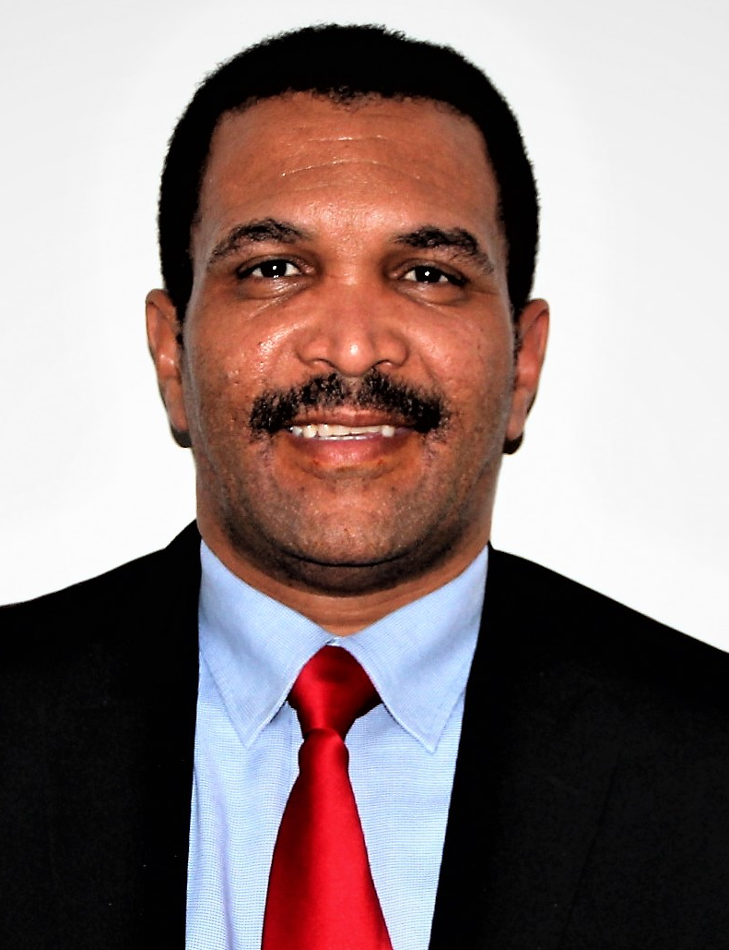
Advocate Deon Ruiters
Senior Maintenance Prosecutor Western Cape
Telephone: 021 487 7196
Email: DRuiters@npa.gov.za

